Slide 1
Event Handling in Spring
The core of Spring is the ApplicationContext, which manages the complete life cycle of the beans.
The ApplicationContext publishes certain types of events when loading the beans. For example, a ContextRefreshedEvent is published when the context is started and ContextClosedEvent is published when the context is stopped.
Event handling in the ApplicationContext is provided through the ApplicationEvent class and ApplicationListener interface. Hence, if a bean implements the ApplicationListener, then every time an ApplicationEvent gets published by the ApplicationContext, that bean is notified.
Spring's event handling is single-threaded so if an event is published, until and unless all the receivers get the message, the processes are blocked and the flow will not continue. Hence, care should be taken when designing your application if the event handling is to be used.
Application Context
Application Listener
Publish
Application Event(e.g ContextRefreshedEvent , ContextClosedEvent
Receive

Slide 2
Event Handling in Spring
ContextRefreshedEvent
This event is published when the ApplicationContext is either initialized or refreshed. This can also be raised using the refresh() method on the ConfigurableApplicationContext interface.
ContextClosedEvent
This event is published when the ApplicationContext is closed using the close() method on the ConfigurableApplicationContext interface. A closed context reaches its end of life; it cannot be refreshed or restarted.

Slide 3
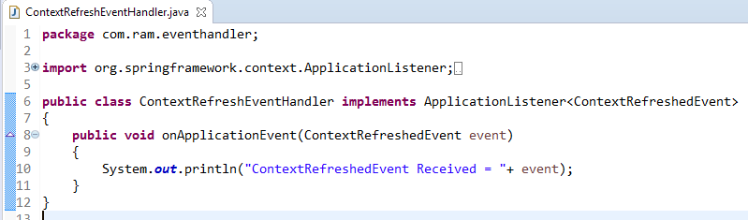
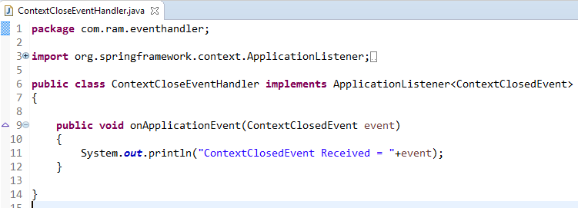
Event Handling in Spring
To listen to a context event, a bean should implement the ApplicationListener interface which has just one method onApplicationEvent().

Slide 4
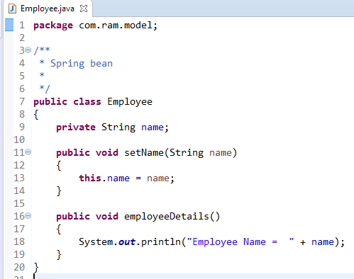
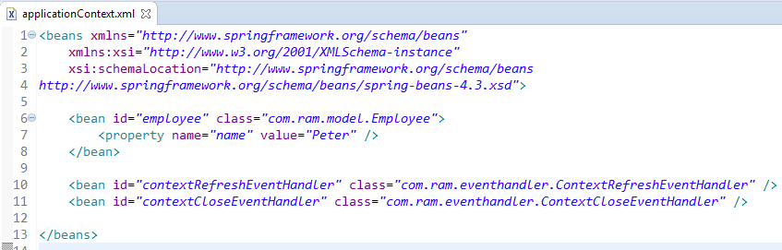
Event Handling in Spring

Slide 5
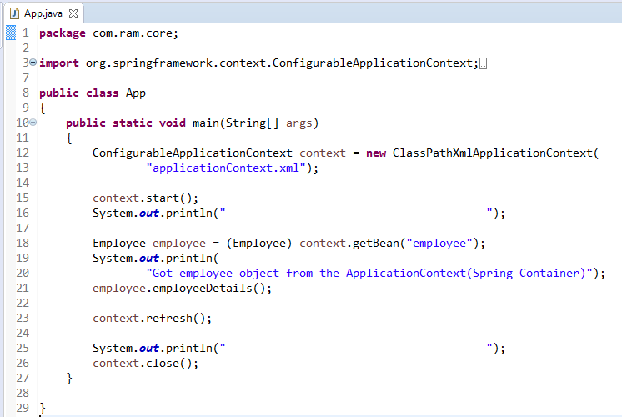
Event Handling in Spring

Slide 6
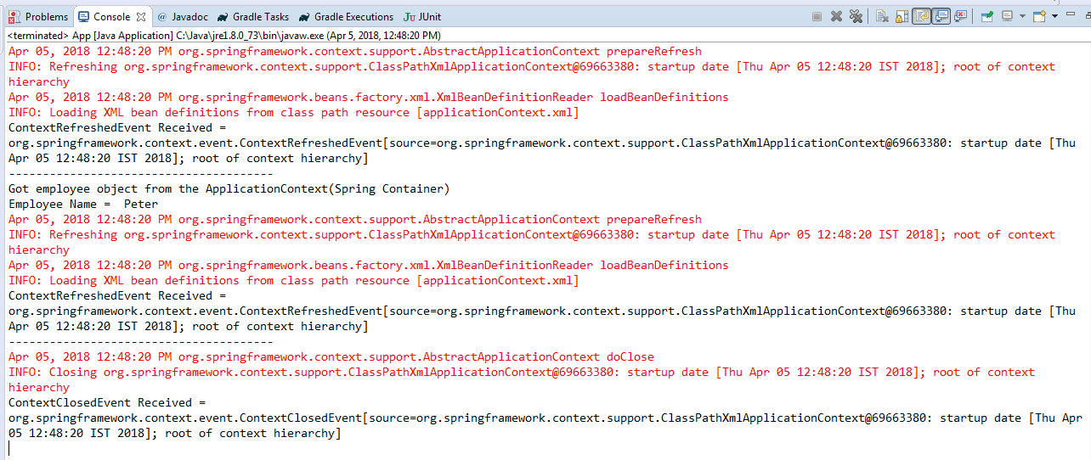
Event Handling in Spring

